Slide 1

Credit Card Financial
Weekly Status Report Power BI

Slide 2




Project Objective
To develop a comprehensive credit card weekly dashboard that provides real-time insights into key performance metrics and trends, enabling stakeholders to monitor and analyze credit card operations effectively.

Slide 3
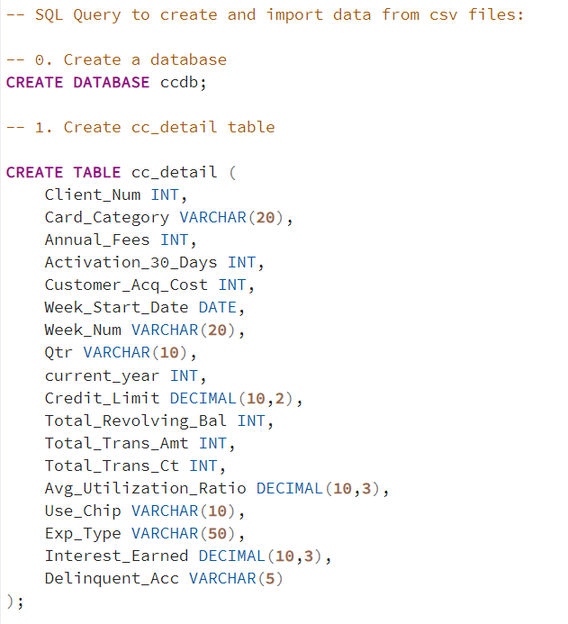
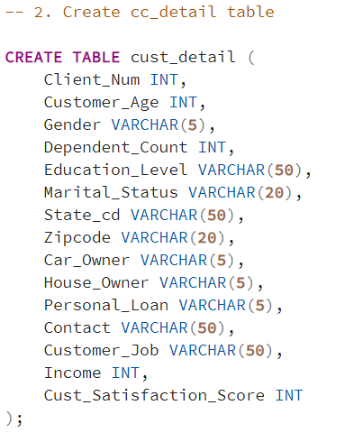
Creating Database in PostgreSQL

Slide 4
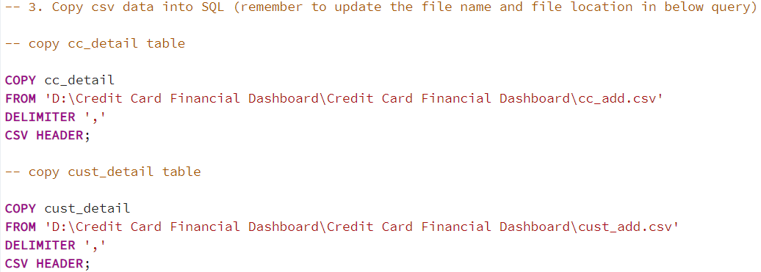
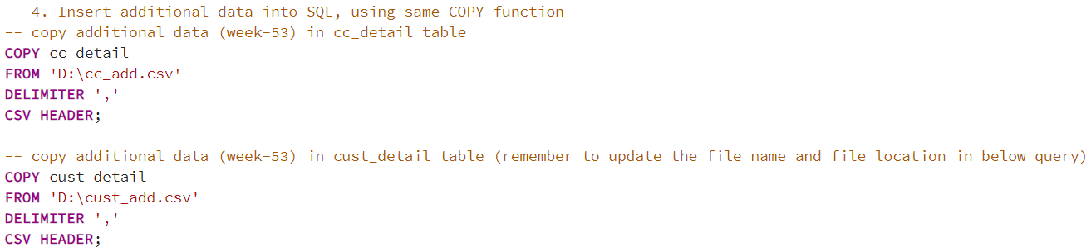
Coping Values to Table

Slide 5


Connecting To Power Bi Through PostgreSQL

Slide 6
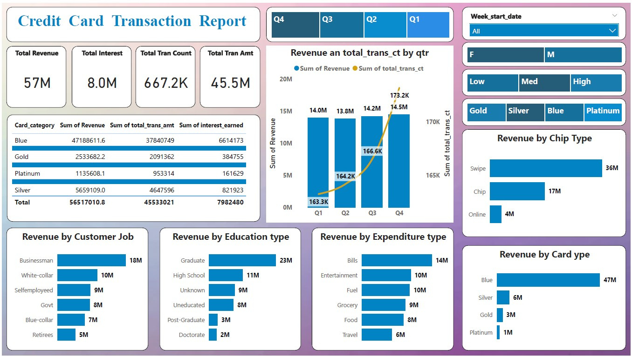
Credit Card Transaction Report

Slide 7
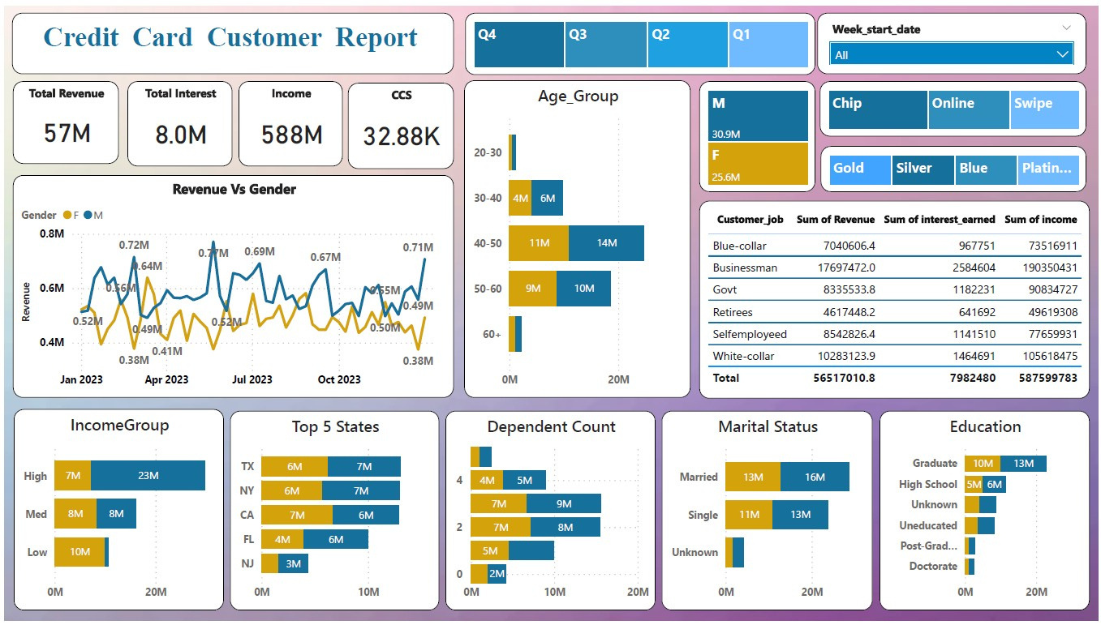
Credit Card Customer Report

Slide 8

Problem Statement
Dashboard:Transaction
Key Performance Indicators(KPIs)
1. Total Revenue
2. Total Interest
3. Total Transaction Count
4. Total Transaction Amount
Bar Chart
1. Revenue Vs CustomerJob
2. Revenue Vs Education Type
3. Revenue Vs Expenditure Type
4. Revenue Vs Card Type
5. Revenue Vs Chip Type
Grid View:-Card Type and Sum of Revenue, Sum of Interest, Sum of Transaction Amount

Slide 9

Problem Statement
Dashboard:Customer
Key Performance Indicators(KPIs)
1. Total Revenue
2. Total Interest
3. Total Income
4. Total Customer Satisfaction
Bar Chart
1. Revenue Vs Income Group
2. Revenue Vs Top 5 States
3. Revenue Vs Dependant Counts
4. Revenue Vs Martial Status
5. Revenue Vs Education Grop
6. Revenue Vs Age Group
Line Chart:-Revenue Vs Gender On Weekly basis
Grid View:-Customer job and Sum of Revenue, Sum of Interest, Sum of Income

Slide 10
Project Insights Week 53 (31st Dec)
Wow Changes:
Revenue increased by 28.8%
Total Transaction At & Count Increased By 35% & 3.4%
Customer Count Increased By 12.8%
YTD Changes:
Overall revenue is 57M
Total Interest is 8M
Total Transaction Amount is 46M
Male Customers are contributing more in revenue 30.9M Than Female 25.6M
Blue & Silver Credit Card are contributing to 93% of Overall transaction
TX, NY & CA is Contributing is 68%
Overall Activation rate is 57.5%
Overall Delinquent rate is 6.06%

Slide 11
"The future belongs to those who believe in the beauty of their dreams."
— ELEANOR ROOSEVELT

Slide 12

Feedback
Thank you for taking the time to review my presentation. Your feedback is invaluable to me as I strive to continuously improve. Please feel free to share any thoughts or suggestions you have regarding my LinkedIn page or GitHub projects. Your insights will help me enhance my online presence and refine my work.
You can reach me via:
LinkedIn: https://www.linkedin.com/in/milind-shende/
GitHub: https://github.com/Milind-Shende/Credit-Card-Financial
You can email me at milind.shende2408@gmail.com.
Thank you once again for your input!

